Slide 1
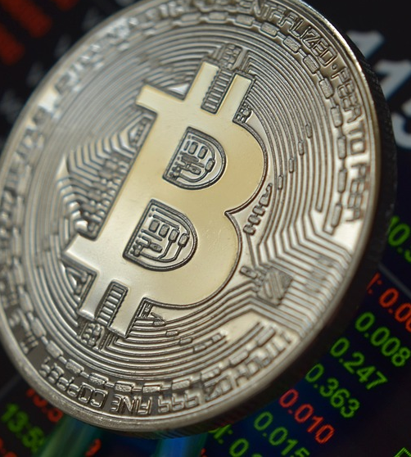
CRYPTO TRACKER
Track cryptocurrencies in real-time
Under the guidance of:
Dr. Rashmi Gupta
Prepared by:
Prachi Raghav

Slide 2
Content
Introduction
Screenshots
Brief description of project.
Snapshots of project
Literature Review
Future Scope
Study of existing project
Add on to the project in future
Technologies Used
Conclusion
Technologies implemented in Crypto Tracker app
Conclusion of Crypto tracker app

Slide 3
Introduction
Crypto currency is decentralized digital money designed to be used over the internet.
User Experience.
Real time data.
Hybrid.
API filtered.
1
Project Description
Problem Statement
2
Lack of financial literacy.
Lack of information about crypto market.

Slide 4
Provide real–time update on crypto currencies
3
Objective

Slide 5
Literature Review
Existing project
Proposed System
65%
75%
Cryptocurrency tracker
Crypto Tracker
Not Hybrid
Poor User Interface
Poor User Experience
Hybrid
Good User Interface
Good User Experience

Slide 6
Technologies Used
Technologies used to develop crypto tracker
Flutter
Dart
Rest API
Framework
Created by Google
Develop Cross platform application
Language
Developed and maintained by Google
Successor of java script
Use java-like syntax
Transfer Information already present online

Slide 7
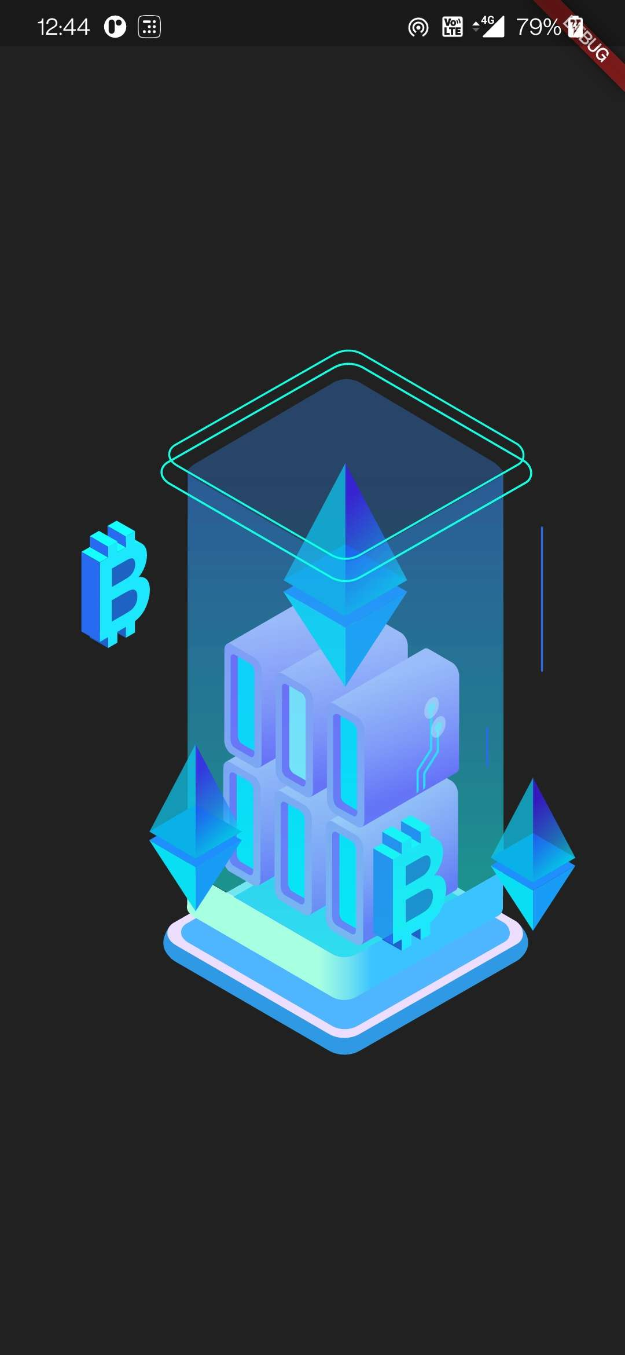
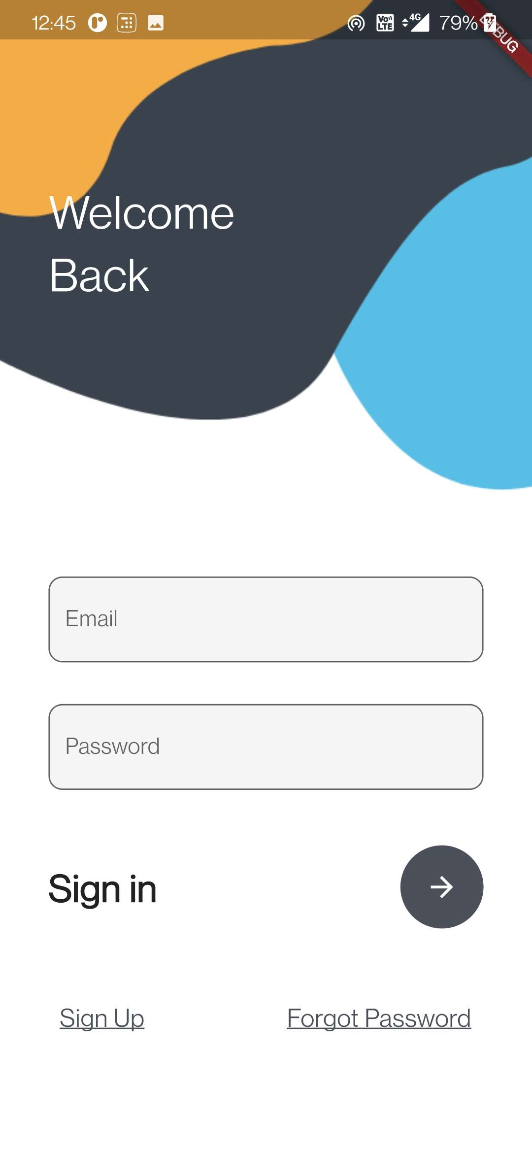
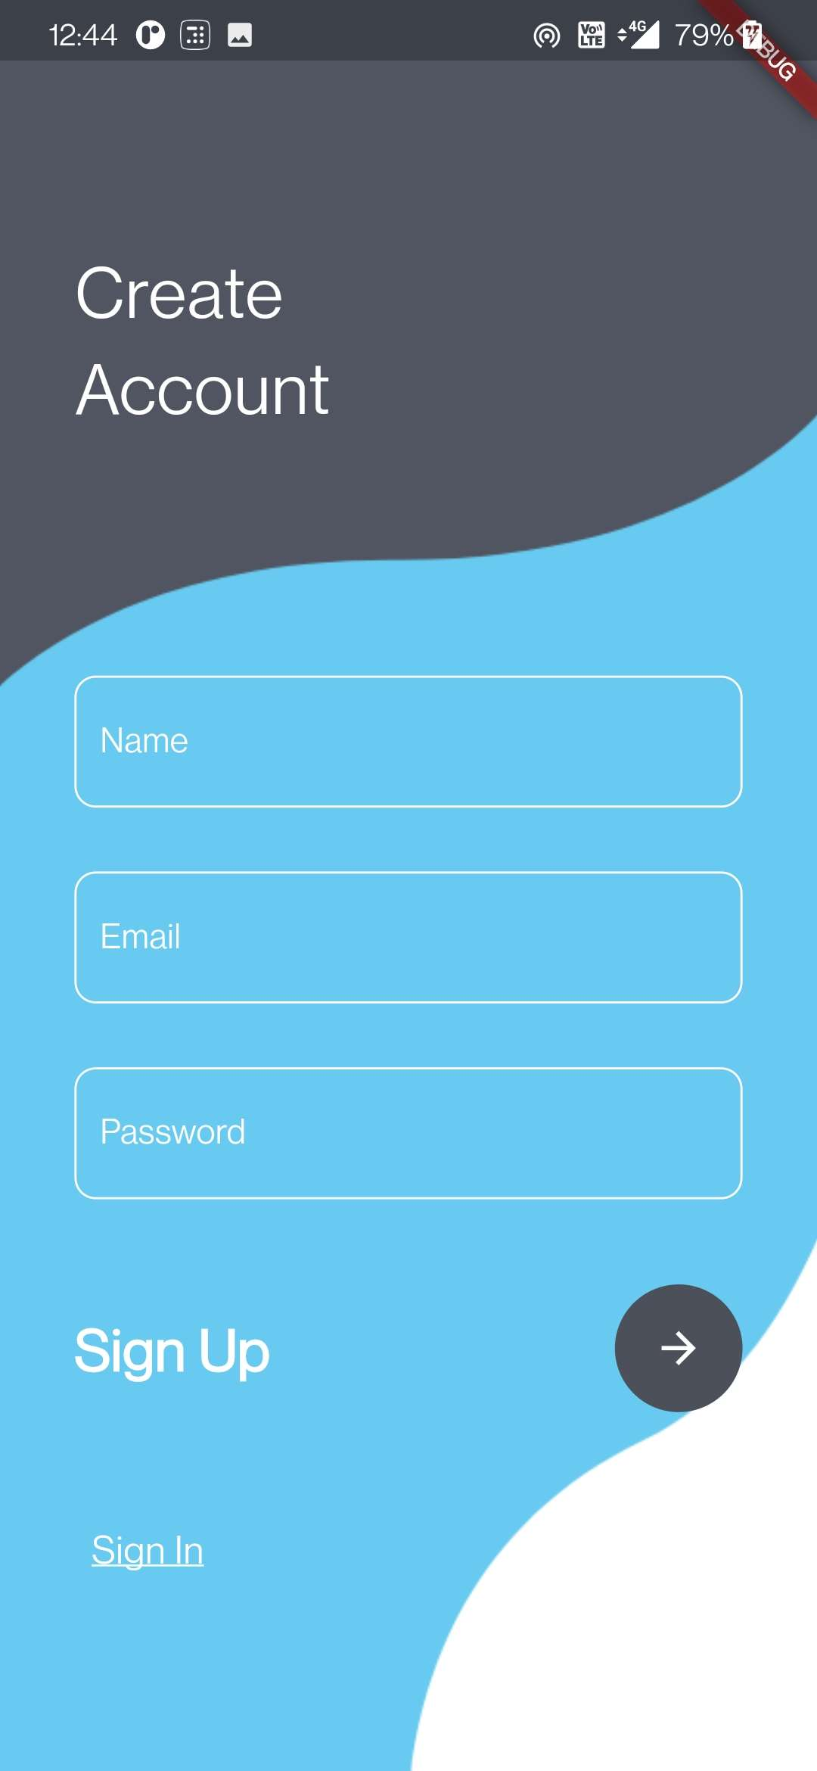
Screenshots
Mobile Mockup

Slide 8
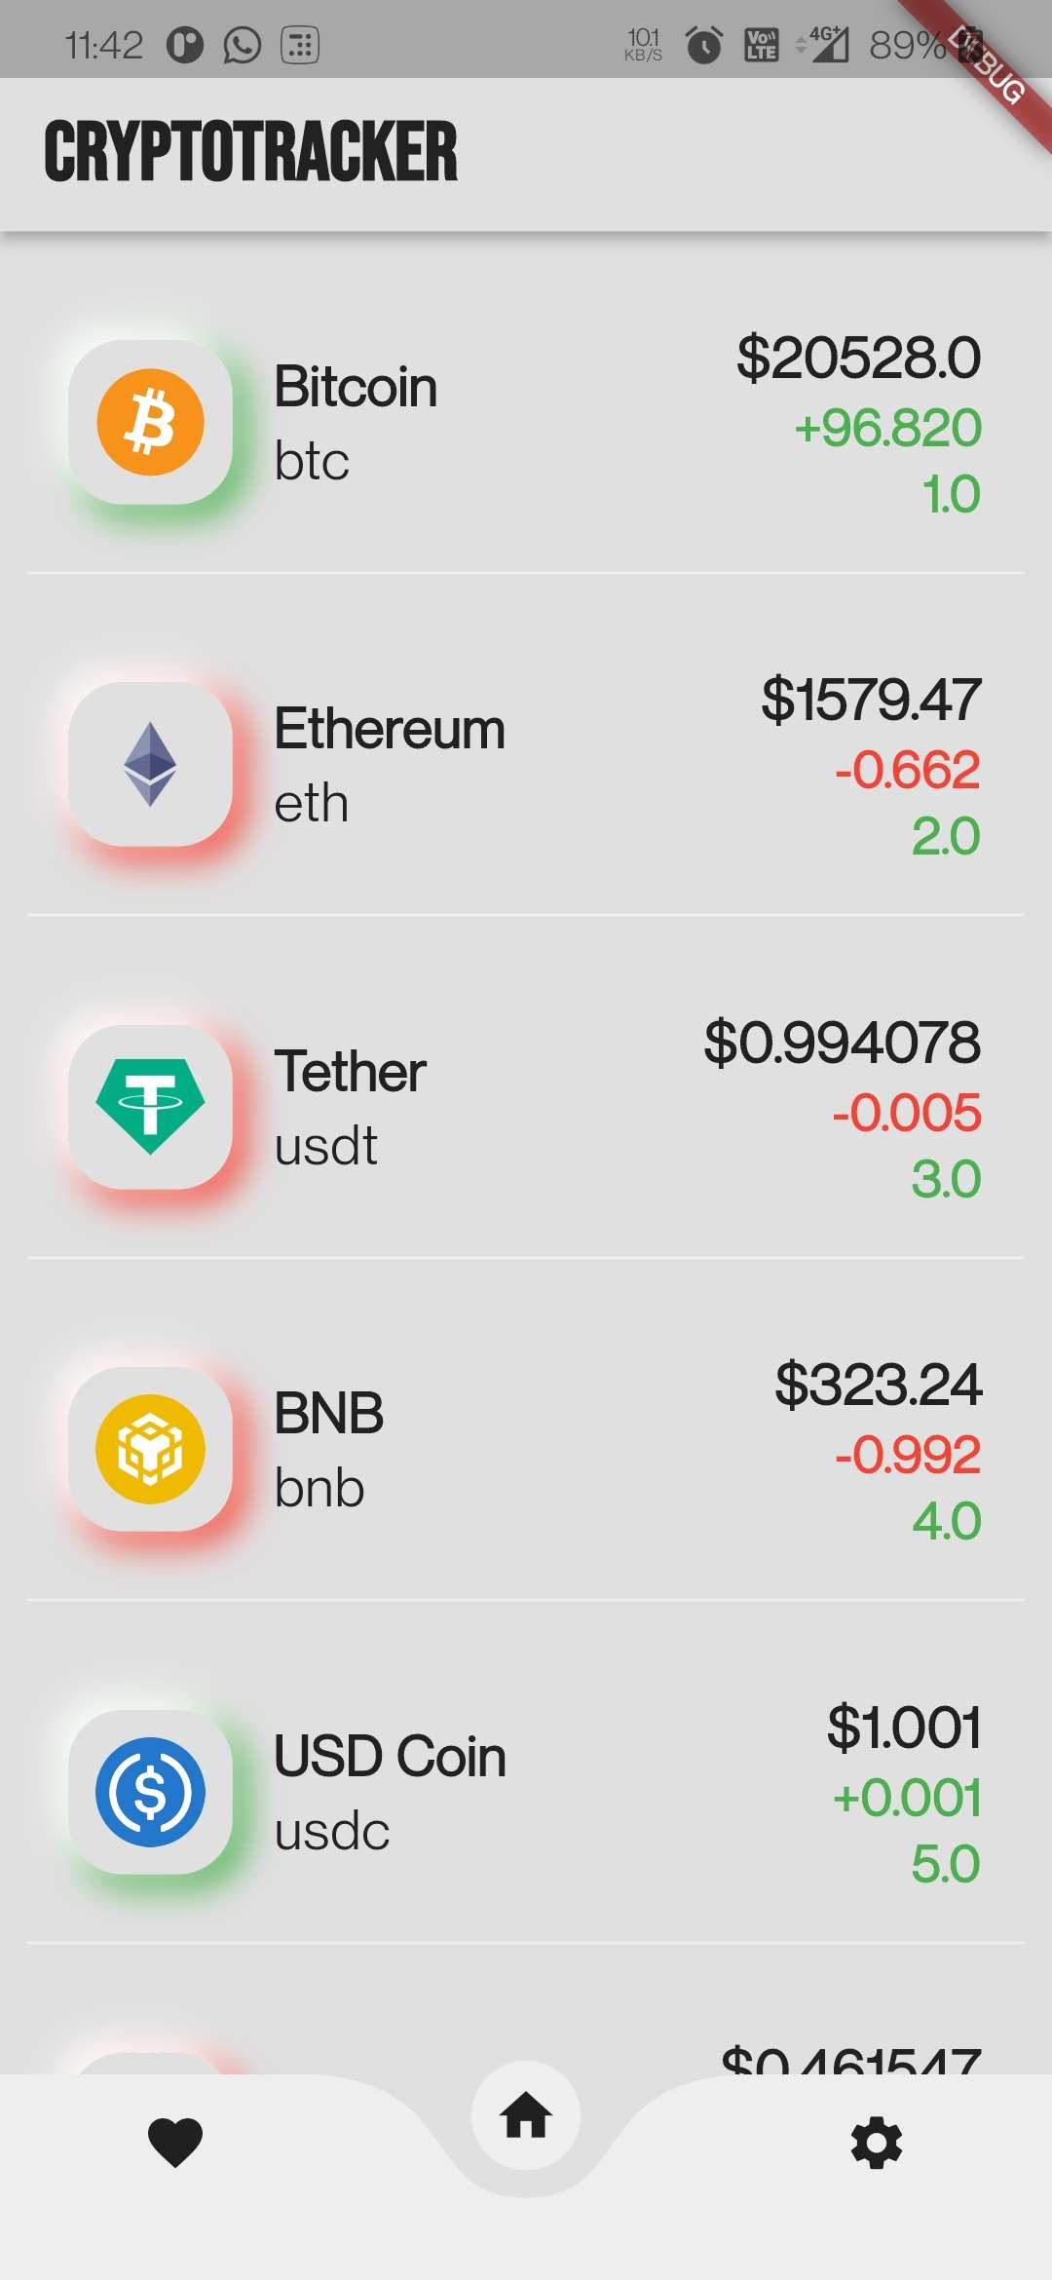
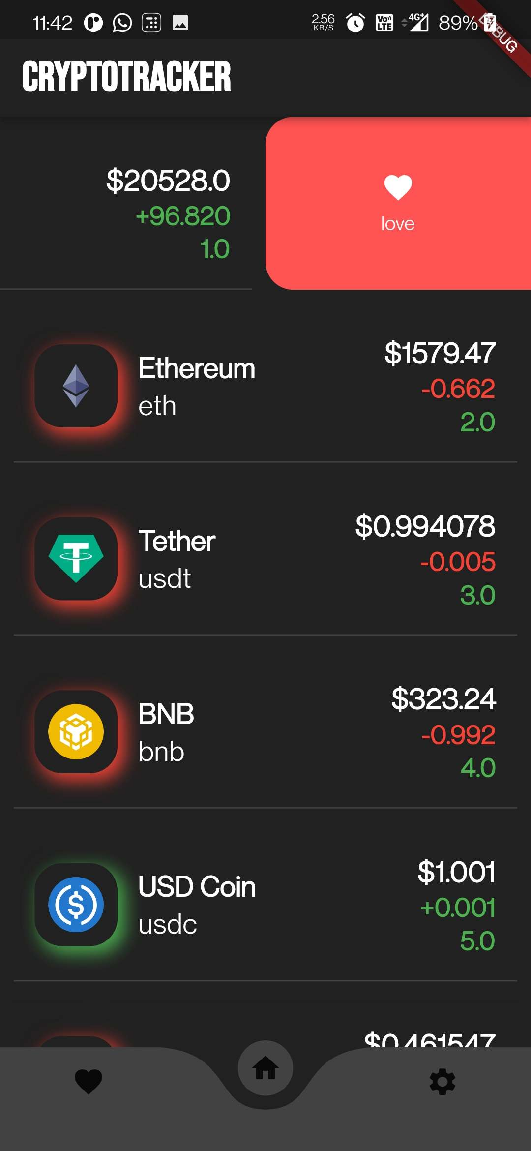
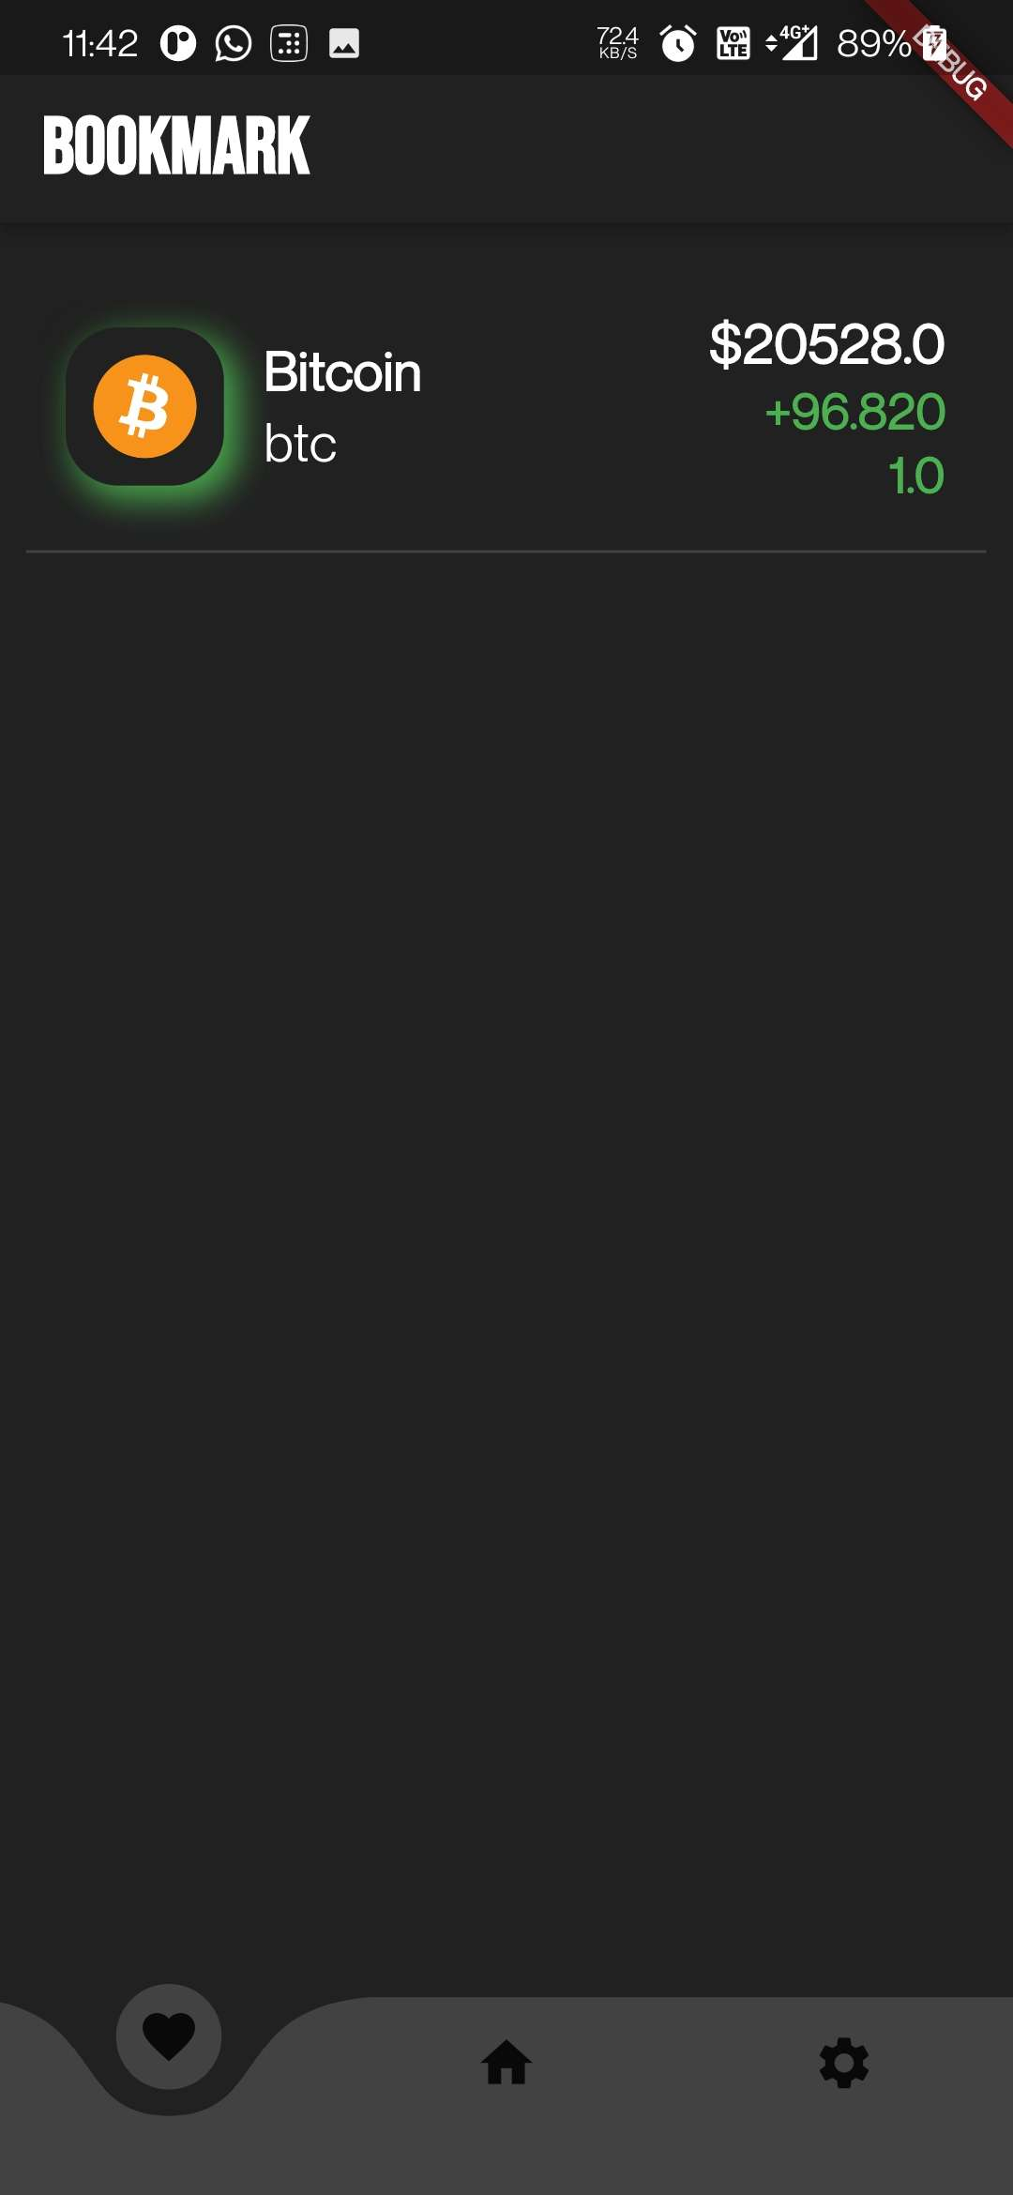

Slide 9
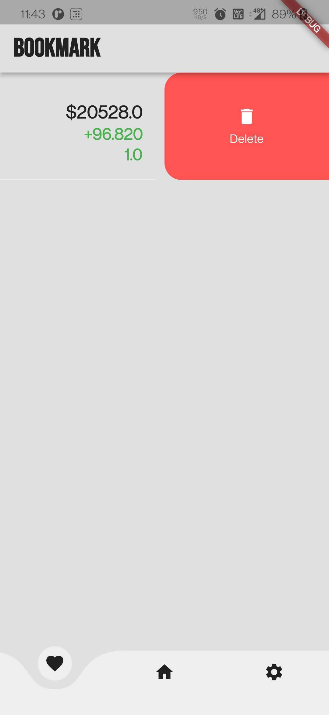


Slide 10
Future Scope and Conclusion
1
2
FUTURE
CONCLUDE
Perdition and analyzing future data
one place to track real-time prices.

Slide 11

Thank You
For Your Patience

